Slide 1
Unsupervised ML algorithms
Olga Lyudchik
Non-member state summer student
Supervisor: Dr. Jean-Roch Valery VLIMANT
(EP-UCM)

Slide 2
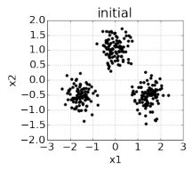
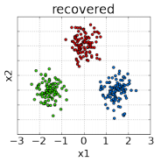
General idea:
Find functional relationship between input variables x and output variables y based on expert knowledge and only x observations:
X₁, X₂, , X_{N}
Unsupervised learning is also known as clustering (for discrete output).

Slide 3
Main unsupervised learning methods
KMean and specific kernel
SOM - Kohonen
Basic auto-encoders
COREX
LSTM Networks

Slide 4
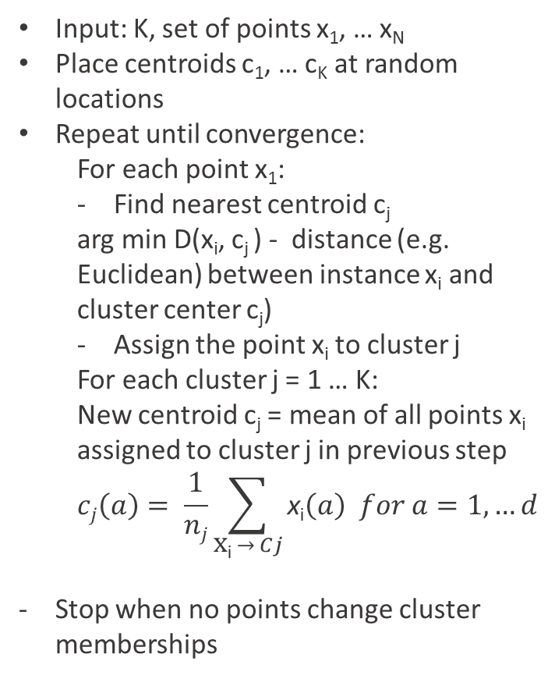
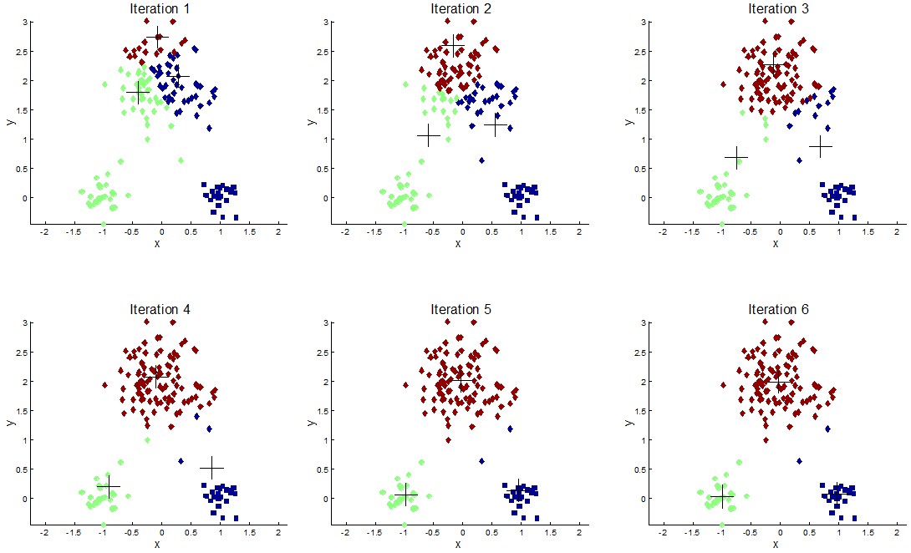
K-means clustering algorithm
Can detect only clusters that are linearly separable!

Slide 5
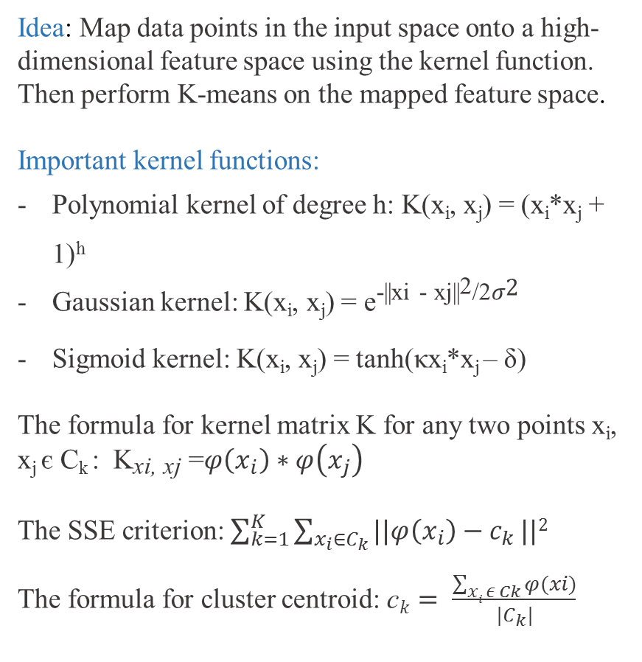
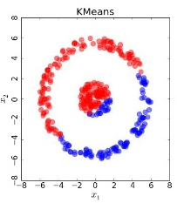
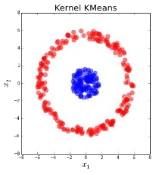
K-means kernel clustering algorithm
Can be used to detect non-convex clusters!

Slide 6
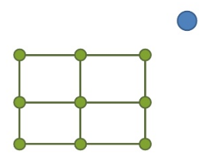
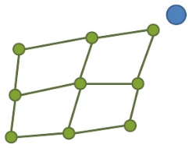
Self-organizing map (Kohonen)
SOM is a technique which reduce the dimensions of data through the use of self-organizing neural networks.
W_{v}(t) = weight vector,
α(t) = monotonically decreasing learning coefficient,
D(t) = the input vector,
Θ (v, t) = neighborhood function
W_{v}(t + 1) = W_{v}(t) + Θ (v, t)α(t)(D(t) - W_{v}(t))
Algorithm:
Randomize the map's nodes' weight vectors.
Grab an input vector.
Traverse each node in the map.
Update the nodes in the neighborhood of Best machine unit by pulling them closer to the input vector.
W_{v}(t + 1) = W_{v}(t) + Θ(t)α(t)(D(t) - W_{v}(t)).
5. Increase t and repeat from step 2 while t < λ, λ – number of cycles.
Step 3
Step 4

Slide 7
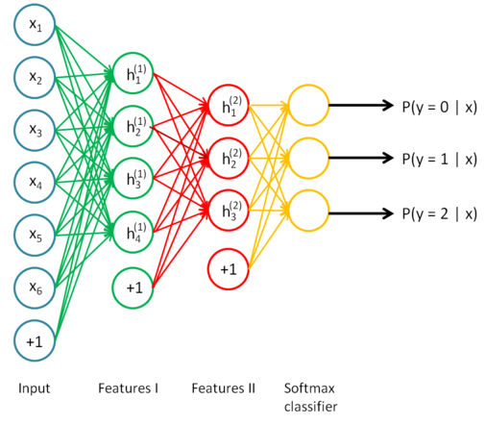
Basic auto-encoders
Idea: Input = decoder(encoder(input))
Takes an input vector x ∈ [0, 1]^{d} and maps it to a hidden representation y ∈ [0, 1]^{d} through a deterministic mapping y = h_{θ}(x) = s(Wx + b), parameterized by θ = {W, b}.
W is a d’ × d weight matrix, b is a bias vector and s is the sigmoid³ activation function, s(x) = 1/(1+e^{−x})
The hidden representation y, sometimes called the latent representation, is then mapped back to a reconstructed vector z ∈ [0, 1]^{d}, where z = gθ’(y) = s(W’y + b’), with θ’ = {W’, b’}

Slide 8


COREX
Algorithm:
Input : A matrix of size n_{s} x n representing n_{s} samples of n discrete random variables
Set : Set m, the number of latent variables, Y_{j} , and k, so that |Y_{j}| = k
Output: Parameters a_{i,j} , p(y_{j}|x_{i}), p(y_{j} ), p(y|x^{(l)} ) for i є N_{n}, j є N_{m}, l є N_{ns}, y є N_{k}, x_{i} є X_{i}
Randomly initialize a_{i,j} , p(y|x^{(l)} );
Repeat
Estimate marginals, p(y_{j} ), p(y_{j} |x_{i}) using the following eq.:
Calculate I(X_{i} : Y_{j} ) from marginals;
Update a using the following eq.:
Calculate p(y|x^{(l)} ), l = 1,...,n_{s} using the following eq.:
until convergence;

Slide 9
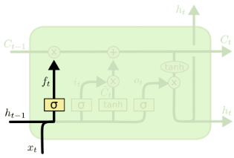
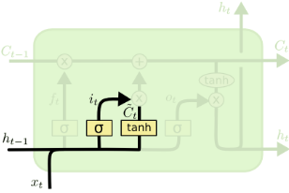


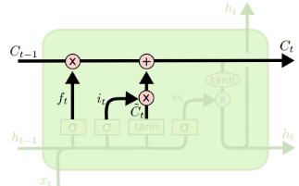
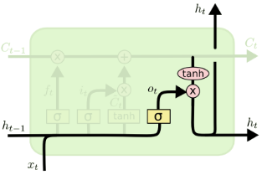


LSTM Networks
- kind of RNN, capable of learning long-term dependencies
Step 1
Step 2
Step 3
Step 4

Slide 10
Thank you for attention!

